Slide 1
Mod510: project 1
Automatic for the people
By malvin varpe & Torgrim odde

Slide 2
Agenda
Introduction & motivation
Floating point & machine precision
Python lists vs NumPy
Boolean operations
Numerical differentiation
Classes
Automatic differentiation
Key takeaways & Lessons learned

Slide 3

introduction
Purpose
Floating point arithmetic
Numerical differentiation
Dual numbers
Why it matters
Numerical methods and machine precision
Notes:
Motivation: Explore
Floating point arithmetic
Numerical differentiation
Dual numbers
Goal:
Understand computational precision and automatic differentiation
Why:
Fundamentals to machine computing and machine learning

Slide 4
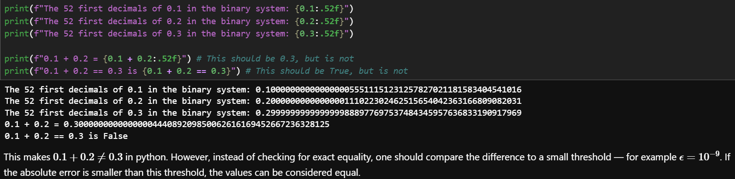
Floating point & machine precision
Ieee 754 double-precision format
System limits
Manual calculation
Key lessons
Notes:
IEEE 754 double precision can not exactly represent some decimals
System limits:
Largest representable number (sys.float_info.max)
Smallest representable number (sys.float_info.min)
Machine epsilon (sys.float_info.epsilon)
Manual calculations
Mantissa
Exponential formulas
Key lessons
Decimal fractions (eg 0.1) cannot be exactly represented in binary -> 0.1 + 0.2 != 0.3

Slide 5
Python lists vs Numpy
When is python good enough?
When should we use numpy?
Notes:
Python lists are fine for small simple sequences
NumPy for large scale and vectorized numerical work

Slide 6
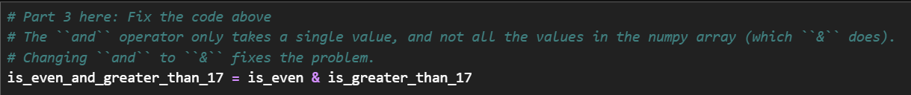
Boolean operations
And vs &
Notes:
In the problem we received a Boolean operations question regarding the difference between & and and function in python. With the ‘and’ operator it only takes a single value, while the ‘&’ works with numpy arrays and will check for all the individual values.

Slide 7
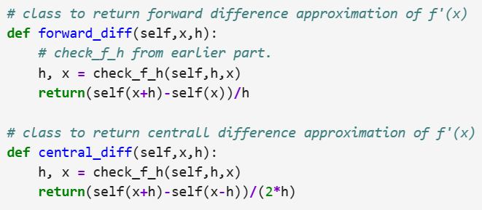
Numerical differentiation
Forward difference
Central difference
Approximations vs analytical derivatives
Absolute error and step size
Key lessons
Notes:
Estiamtion of the derivative is possible in finite precision systems by approximation. Two examples of this are the forward dffference and central difference method, in which we can see how we implemented in python the powerpoint. These can be derived from the Taylors formula, which is a way to express functions through sums.

Slide 8
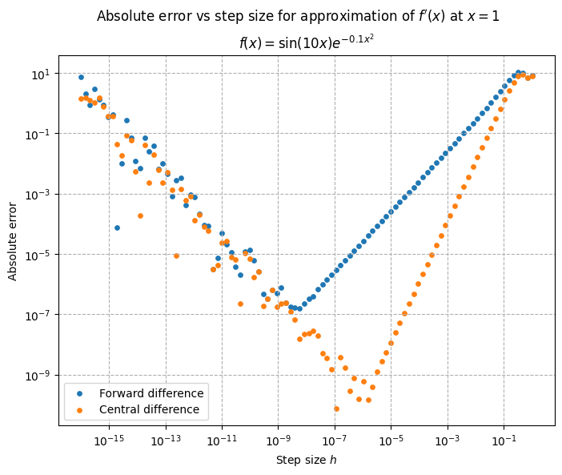
Numerical differentiation
Forward difference
Central difference
Approximations vs analytical derivatives
Absolute error and step size
Key lessons
Notes:
Forward vs central difference errors comparison
Shows:
Best accuracy at intermediate h
Round off dominates for low h
Central difference curve stays lower

Slide 9

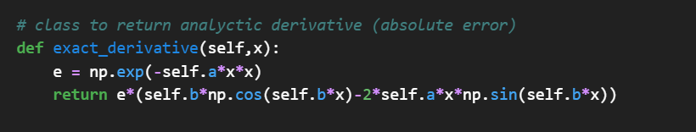
classes
Encapsulation
flexibility
Notes:
Encapsulates a wave packet (f(x) = … ) in a Python class
Methods to compute
Forward and central finite-difference derivatives
Exact analytical derivative
Error plots across step sizes
Demonstrates flexibility
Classes can handle several parameters, sets and visualizations
Classes can easily be re-used

Slide 10

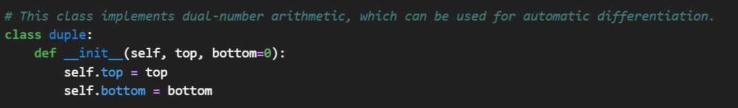

Automatic differentiation
Duple
Overloaded arithmetic operations
insight
Notes:
Duple class
Def __mu1__ illustrates dual-number rule
e-coefficient carries derivative info = foundation of automatic differentiation
x=duple(1,2) #= 3 + 1*e
Definition requirement of overloaded arithmetic operators
Insight:
Dual numbers return both function value and derivative automatically
Fundamental for automatic differentiation

Slide 11
Key lessons & takeaways
Why Machine precision matters
Choice of numerical method
Error behavior
Object oriented design
Automatic differentiation
Notes:
Machine precision matters:
NumPy enables efficient vectorized work
Even simple operations (0.1 + 0.2) show floating-point limitations
Choice of numerical method:
Central difference provides higher accuracy than forward difference
Error behavior:
Too small step size causes round-off errors
Object-oriented design:
Encapsulating math operation in classes improve clarity and make “complex” methods reusable
Automatic differentiation:
Dual numbers provide a mathematical foundation for derivative computations in machine learning libraries

